Slide 1




Slide 2
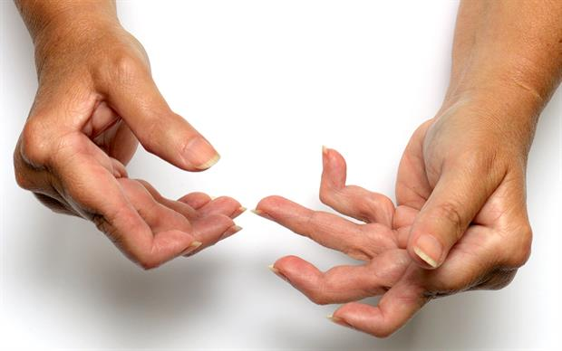
Rheumatoid Arthritis (RA): A chronic and progressive autoimmune disease that causes inflammation of the joints, tremors, joint pain, and restriction of motion.
Profound economic burden
Sense of loss of independence
Psychological strain

Slide 3

Problem at Hand
Diagnostics and monitoring requirements are costly (MRI, X-Rays, MRIs, etc)
Much of patient reported diagnostic data is qualitative
Patient perception of progression can be skewed between office visits due to disease progression rates
Patient ability to question if this condition is possibly affecting them
34% underdiagnosed or misdiagnosed [Rheumatology vol.41 Issue 1, pages 38-45, 88-95 Jan.2002]

Slide 4


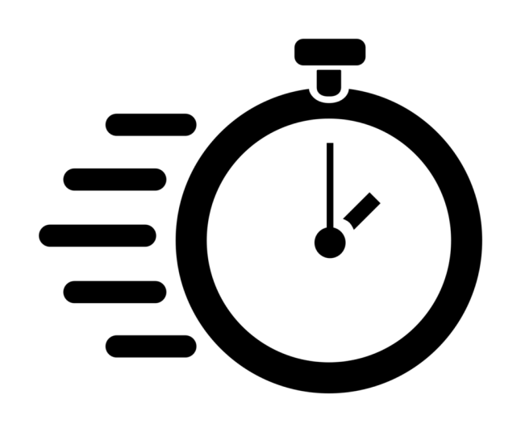

Solution Needs
INEXPENSIVE
QUANTITATIVE
MONITORS PROGRESSION
EARLY INDICATOR

Slide 5
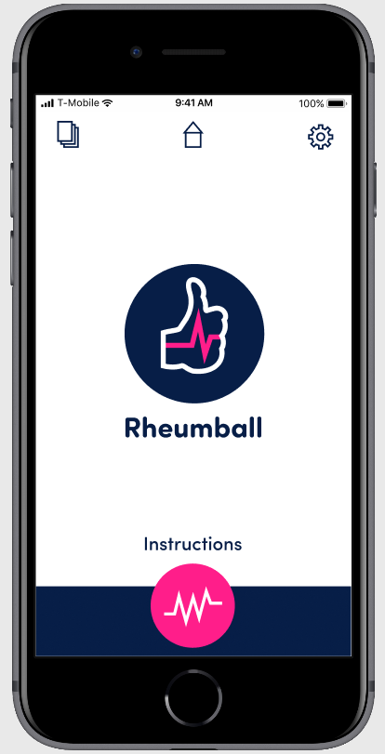
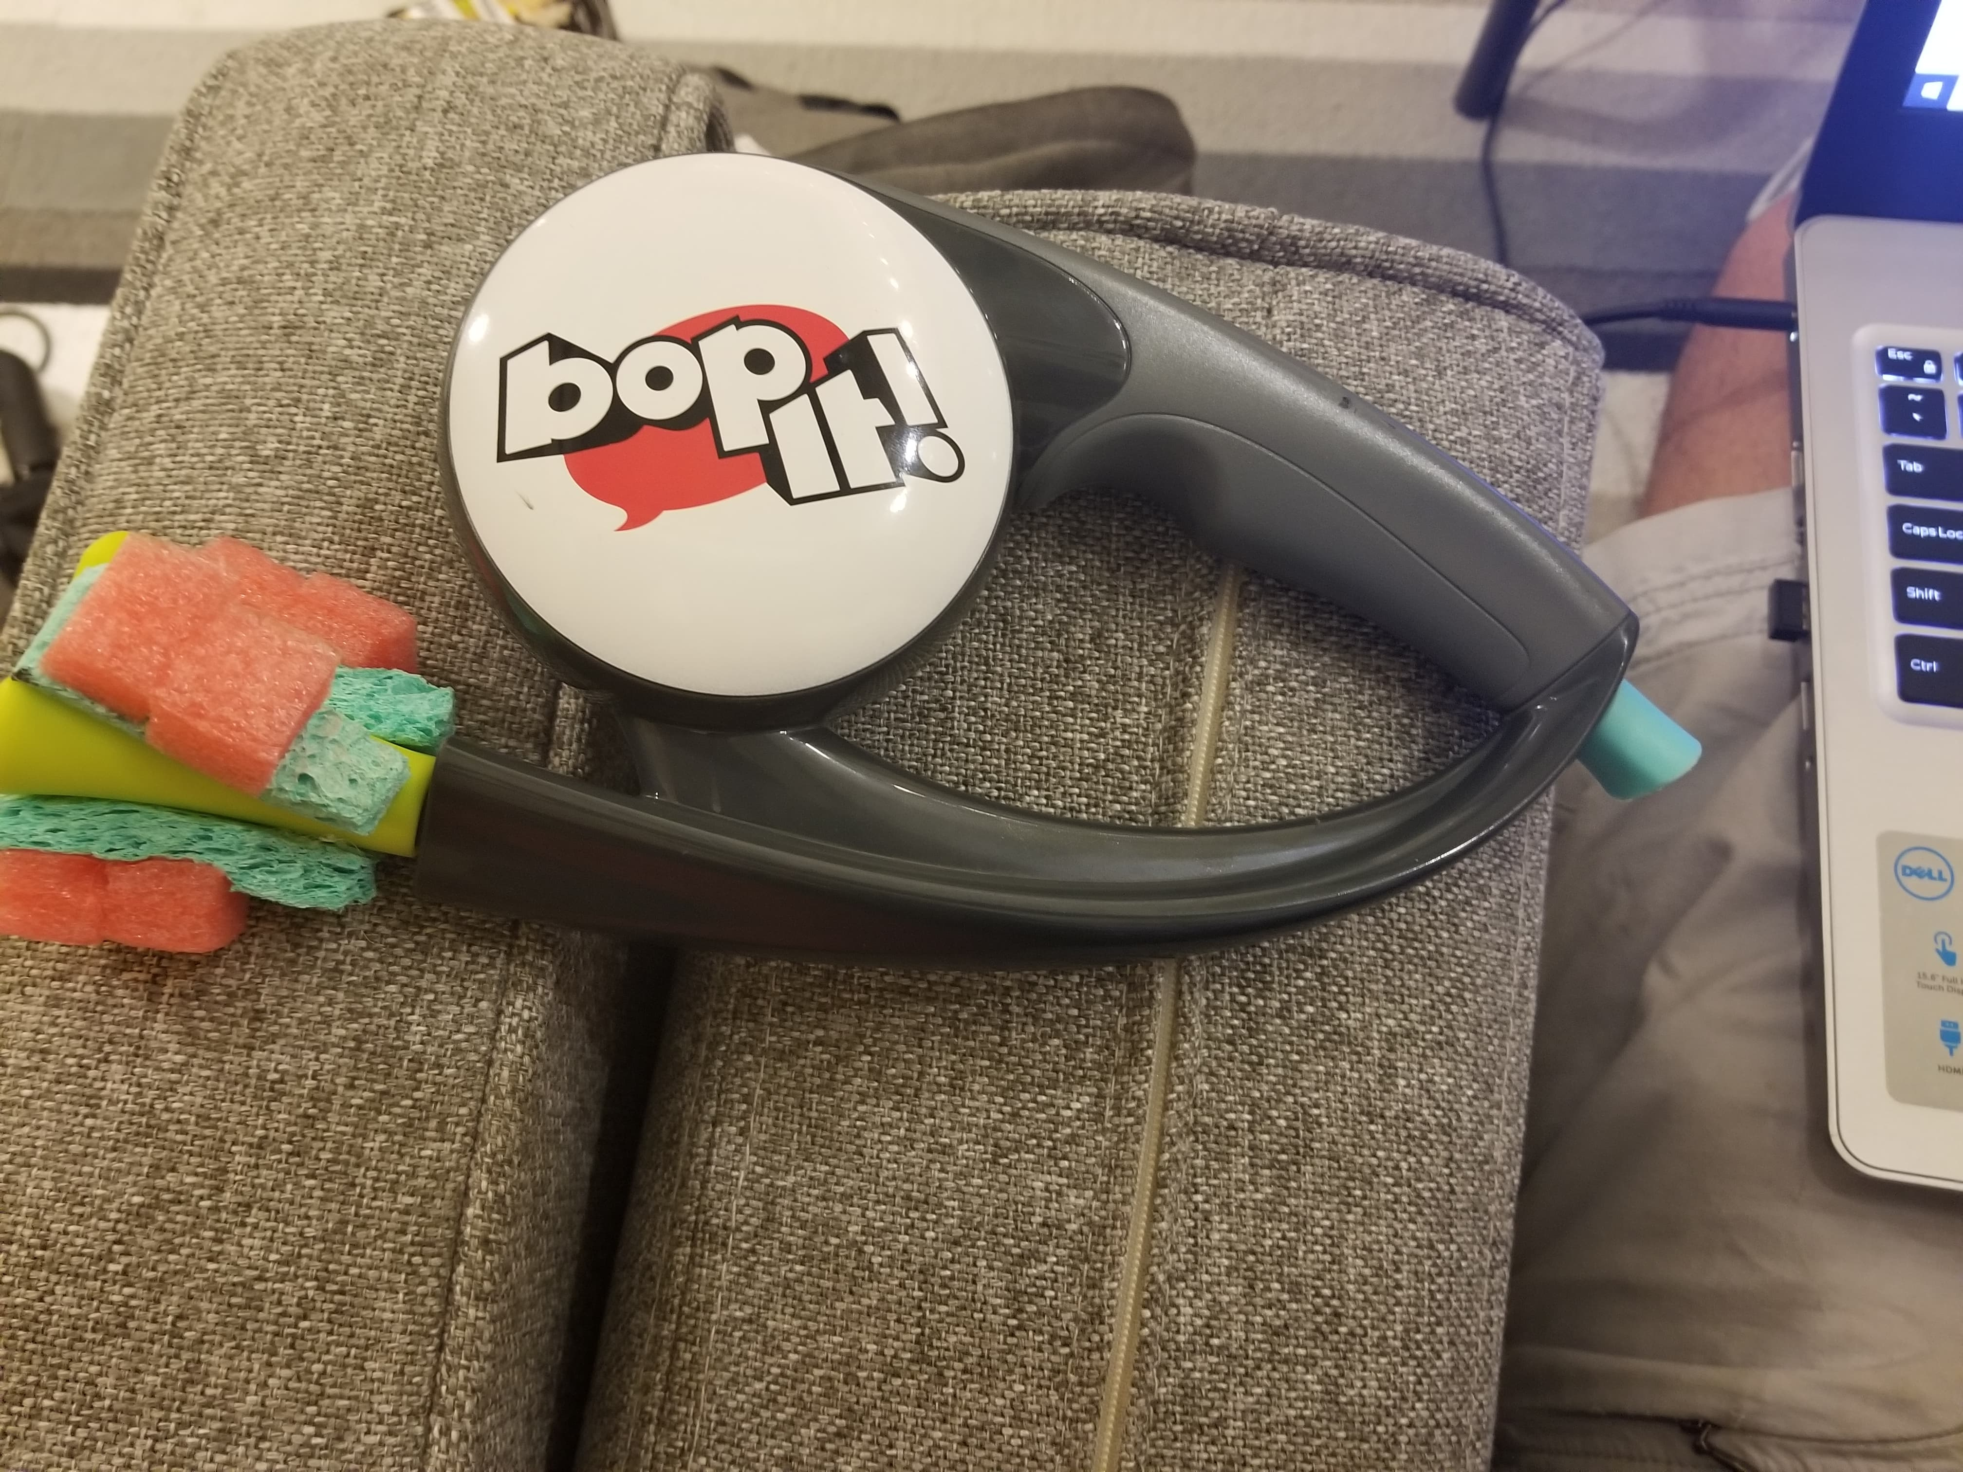
Our Solution: GRASP & The Rheumball
-GRASP Interface for Rheumball Connectivity
Rheumball prototype - based the Bop-It!

Slide 6
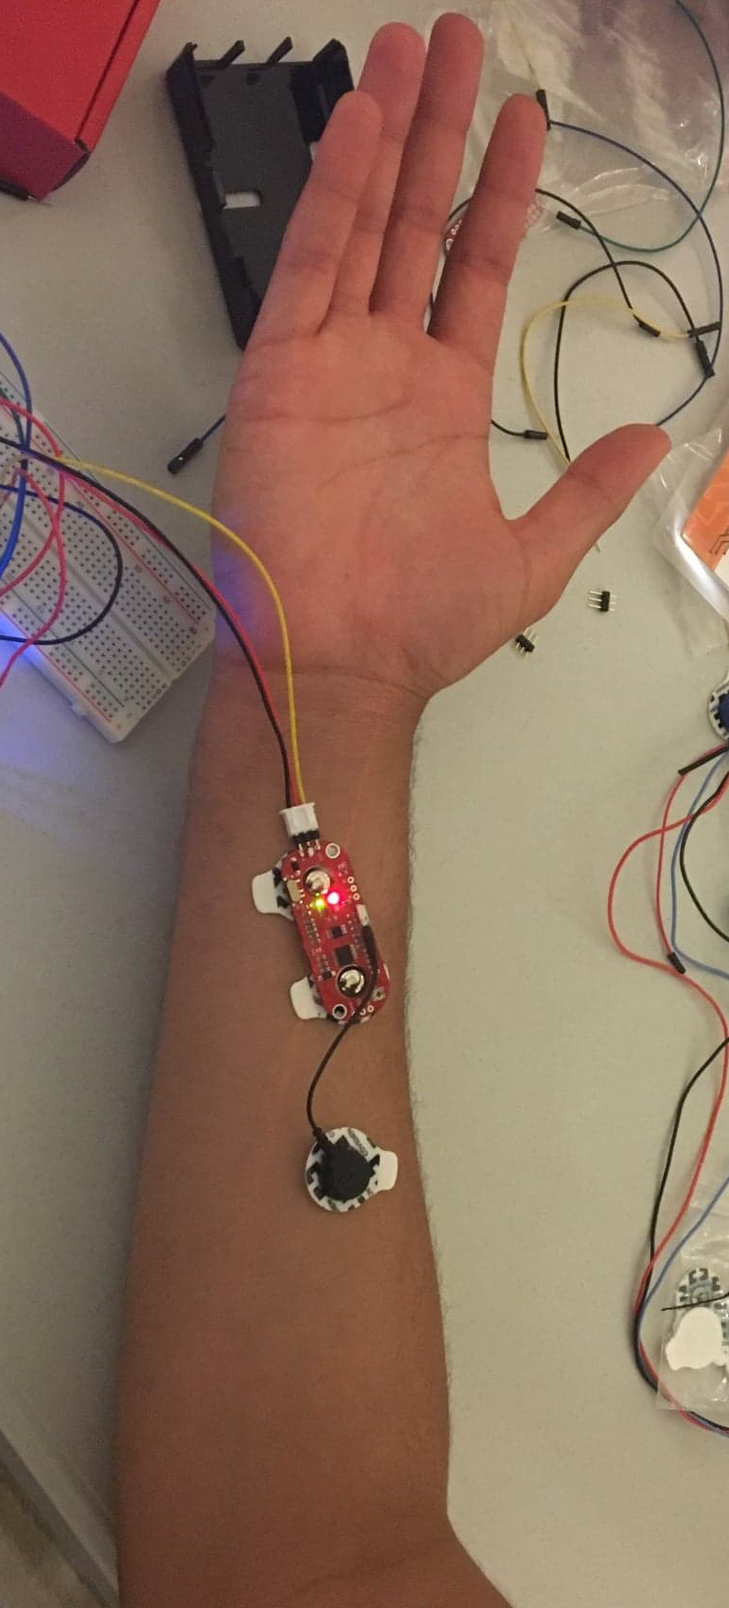
Rheumball Operation & User Interface
DEMO
-EMG + Rheumball

Slide 7
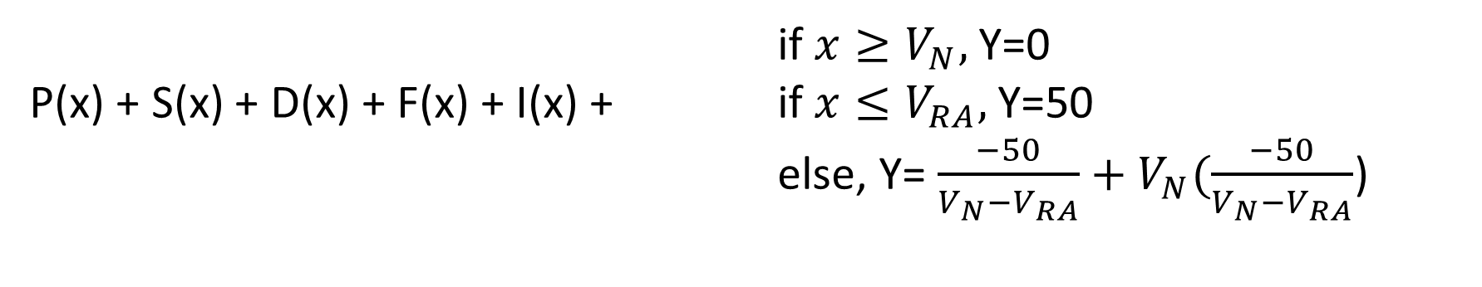
Scoring, Interpretation, and Following Up
if $x≥V_{N},$Y=0
P(x) + S(x) + D(x) + F(x) + I(x) + if $x≤V_{RA},$Y=50
else, Y= $\frac{−50}{V_{N}−V_{RA}}+V_{N}(\frac{−50}{V_{N}−V_{RA}}$)
Score estimates RA progression and likelihood of RA as cause of symptoms based on alignment of symptoms
Pain, Swollenness, Disfigurement, Tremor Frequency, Tremor Intensity (10 max each)
EMG data comparison (50 max)
0 = Lowest/No RA Match, 100 = High RA Match

Slide 8
Future Advancements
EMG electrodes sleeve or band
Alteration of product shape
Update voice compatibility and add audio to final product
Secondary Rheumball for later stages of RA
Mobile App development
Initial dataset required for EMG assessment

Slide 9
Questions?

